Slide 1

Demographic Bias in Presentation Attack Detection of Facial Recognition Tony Gwyn (He/Him), MS Member, Cyber Defense and AI (CDA) Lab Member, Center for Cyber Defense (C2D) North Carolina A&T State University

Slide 2
Agenda/Outline
Self-Introduction
Introduction of Current Research
CNNs and Datasets Utilized
CNN Details
Dataset Details and Sample Data
Tentative Timeline
Gaps and Challenges
Q&A

Slide 3
Self-Introduction
Mr. Tony Gwyn (Tony is fine)
Bachelor’s Degree and Master’s Degree in CS from WSSU
Attended 2005-2020
Master’s Thesis – “Evaluation of Local Binary Pattern Algorithms for the Use of Biometric Authentication”
Doctoral Student at North Carolina A&T from Fall 2020 – Present
Working with Dr. Kaushik Roy
Member, Cyber Defense and AI (CDA) Lab
Member, Center for Cyber Defense (C2D)
Most recently had 2 papers accepted to The 35th International Conference on Industrial, Engineering & Other Applications of Applied Intelligent Systems (MDPI)
“Deepfake Detection Using Multitask Cascaded Neural Network”
“Face Authentication from Masked Face Images Using Deep Learning on Periocular Biometrics”

Slide 4
Introduction of Current Research
Demographic Bias is inherent in many computer systems
Facial recognition tends to favor lighter complexion, male individuals
This research currently makes use of 8 CNNs and 3 distinct Datasets
CNNs selected due to their current use in the field and generally impressive performance
Using accuracy measurements we will investigate which CNN is the most fairly balanced when it comes to gender and/or demographic bias
Ideally, this research will lead to increased awareness of the issue of demographic bias
Additionally, we plan to examine tested CNNs to potentially create a new model that is demographic independent

Slide 5
CNNs and Datasets Utilized
Convolutional Neural Networks (CNNs): 8 in total
AlexNet, Xception, Inception v2 and v3, ResNet50 and 101, VGG16 and VGG19
Standard versions of each of these CNNs are currently implemented
‘Enhanced’ versions being tested for implementation
More robust, higher accuracy, etc.
Several other CNNs currently being investigated
Ideally 10+ CNNs for final testing iteration
Datasets: 3 in total
Wide Multi Channel Presentation Attack (WMCA)
CASIA Face Anti-Spoofing Database (CASIA-FASD)
Spoofing in the Wild Database (SiW)
Datasets have been implemented and tested independently

Slide 6
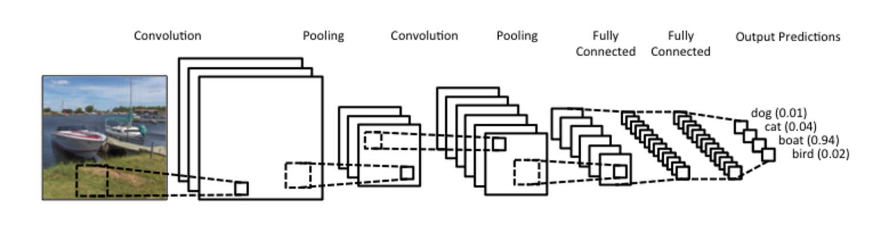
CNN Details
What are Convolutional Neural Networks (CNNs)?
Figure 1: Basic Convolutional Neural Network

Slide 7
CNN Details Continued
AlexNet
CNN architecture that seeks to reduce training time and increase optimizations when used with Graphics Processing Units (GPUs)
Seeks to increase overall accuracy and performance when compared with other methods
Figure 2: AlexNet architecture recreation

Slide 8
CNN Details Continued
Inception v2/v3
While most popular CNNs stack convolution layers deeper, Inception instead goes wider
Due to this, it is extremely important for Inception to have a specific kernel size for the task at hand:
A larger kernel size is preferred when dealing with salient information for the entire image
A smaller kernel size is preferred when the image information is more local
Version 2 and 3 share some similarities, yet can have substantial differences in image classification accuracy

Slide 9
CNN Details Continued
Inception v2/v3
v2 reduces the potential bottleneck and loss of information from v1
v3 introduces 7-by-7 convolutions, and adjusts some auxiliary classifiers from v2
Figure 3: Recreated Inception architecture with dimension reductions

Slide 10
CNN Details Continued
Xception
Could be considered an ‘extreme’ version of Inception
Performs 1-by-1 convolutions to every channel
Adds a 3-by-3 calculation to each of those outputs
This calculation creates depthwise separable convolutions
Used by Xception to make its classification predictions
Figure 4: A recreation of the original Xception architecture
Figure 4: Recreated Inception architecture with dimension reductions

Slide 11
CNN Details Continued
VGG-16/VGG-19
Well-established CNN models that work best for image classification and object localization
Uses a relatively small architecture of 3-by-3 convolution features for image classification accuracy
The number associated with each VGG is the total number of depth layers:
The most widely used being VGG-16 and VGG-19
While attaining impressive levels of accuracy, VGG does have several drawbacks that make it difficult to implement
The robustness of VGG makes it particularly slow to train, even when using high powered GPUs
Additionally, when VGG was first utilized, the size of its weights caused for a sizable amount of bandwidth and disk space to be allocated

Slide 12
CNN Details Continued
ResNet50/ResNet101
For improved image classification and accuracy, neural networks need to continue to go deeper and more complex
The specific architecture of ResNet was created to help solve this problem
By stacking additional convolutional layers, ResNet is able to increase both performance and overall image accuracy
Adding layers needs to be balanced, as adding too many layers can be problematic
Potentially increasing error percentages when compared to ResNets with fewer layers

Slide 13
CNN Details Continued
Layer name | Output size | 18-layer | 34-layer | 50-layer | 101-layer | 152-layer
conv1 | 112x112 | 7 x 7, 64, stride 2
 |  | 3 x 3 max pool, stride 2
 |  | [3x3, 64] | [3x3, 64] | [1x1, 64 ] | [1x1, 64 ] | [1x1, 64 ]
conv2.x | 56x56 | [3x3, 64] x 2 | [3x3, 64] x 3 | [3x3, 64 ] x3 | [3x3, 64 ] x3 | [3x3, 64 ] x3
 |  |  |  | [1x1, 256] | [1x1, 256] | [1x1, 256]
 |  | [3x3, 128] | [3x3, 128] | [1x1, 128] | [1x1, 128] | [1x1, 128]
conv3.x | 28x28 | [3x3, 128] x2 | [3x3, 128] x4 | [3x3, 128] x4 | [3x3, 128] x4 | [3x3, 128] x8
 |  |  |  | [1x1, 512] | [1x1, 512] | [1x1, 512]
 |  | [3x3, 256] | [3x3, 256] | [1x1, 256] | [1x1, 256] | [1x1, 256]
conv4.x | 14x14 | [3x3, 256] x2 | [3x3, 256] x6 | [3x3, 256] x6 | [3x3, 256] x23 | [3x3, 256] x36
 |  |  |  | [1x1, 1024] | [1x1, 1024] | [1x1, 1024]
 |  | [3x3, 512] | [3x3, 512] | [1x1, 512] | [1x1, 512] | [1x1, 512]
conv5.x | 7x7 | [3x3, 512] x2 | [3x3, 512] x3 | [3x3, 512] x3 | [3x3, 512] x3 | [3x3, 512] x3
 |  |  |  | [1x1, 2048] | [1x1, 2048] | [1x1, 2048]
 | 1x1 | average pool, 1000-d fc, softmax
FLOPs |  | 1.8 x 10⁹ | 3.6 x 10⁹ | 3.8 x 10⁹ | 7.6 x 10⁹ | 11.3 x 10⁹
ResNet50/ResNet101 are ideal candidates to be included in this study
ResNet50 could be considered the ‘standard’ ResNet version
It has seen great success in the realm of image classification
ResNet101 is an ‘enhanced’ version of ResNet
It has gone up against state-of-the-art CNNs such as VGG-16 and has produced impressive results
Figure 5: A recreation of ResNet architectures

Slide 14
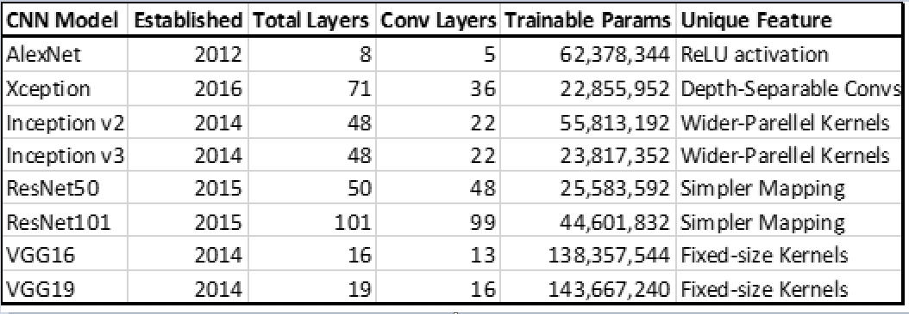
CNN Details Continued
Table 1: Current CNN configurations with number of parameters and unique features

Slide 15
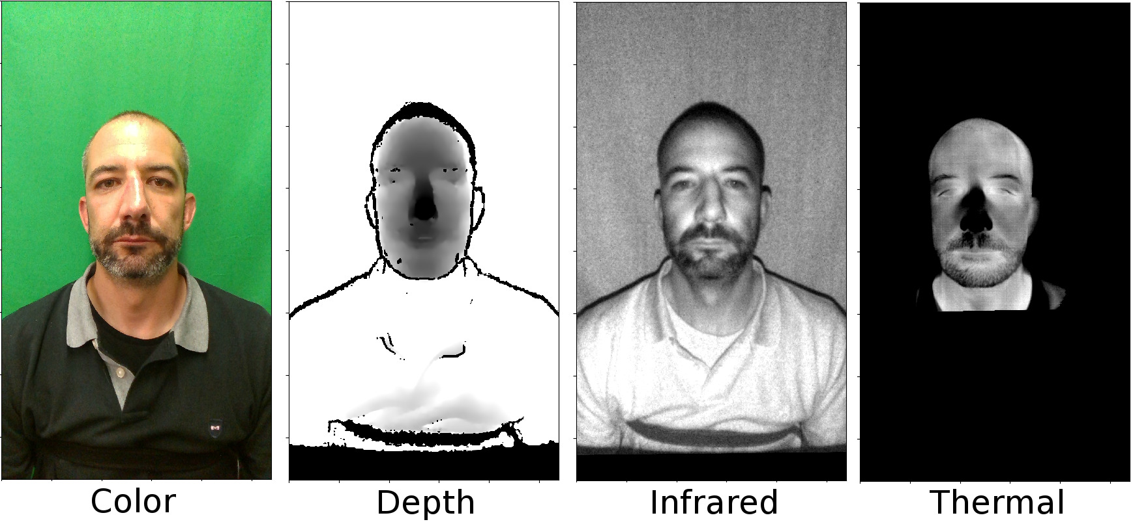
Dataset Details
Wide Multi Channel Presentation Attack (WMCA) Dataset
Created by Anjith George et. Al
Uses data from both genuine and presentation attacks
WMCA Dataset contains data recorded from several channels including depth, infrared, and color
Dataset has a total of 1941 short video recordings from 72 distinct identities
Figure 6: Images from the WMCA Dataset

Slide 16
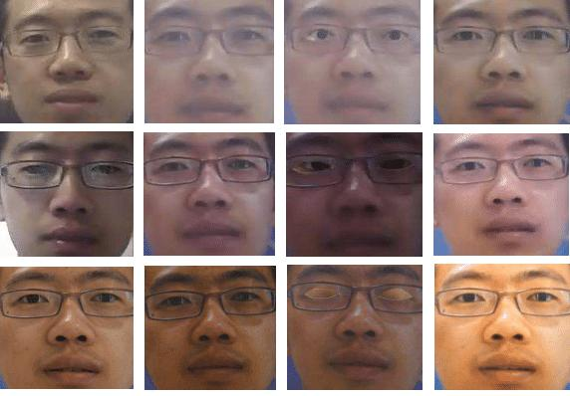
Dataset Details
CASIA Face Anti-Spoofing Dataset (CASIA-FASD)
Introduced by Zwihei Zhang et. al
Small face anti-spoofing dataset with 50 genuine subjects
Face faces are created from high quality images of genuine faces
Final dataset contains 600 videos (both real and fake individuals)
Figure 7: Images from the CASIA-FASD

Slide 17
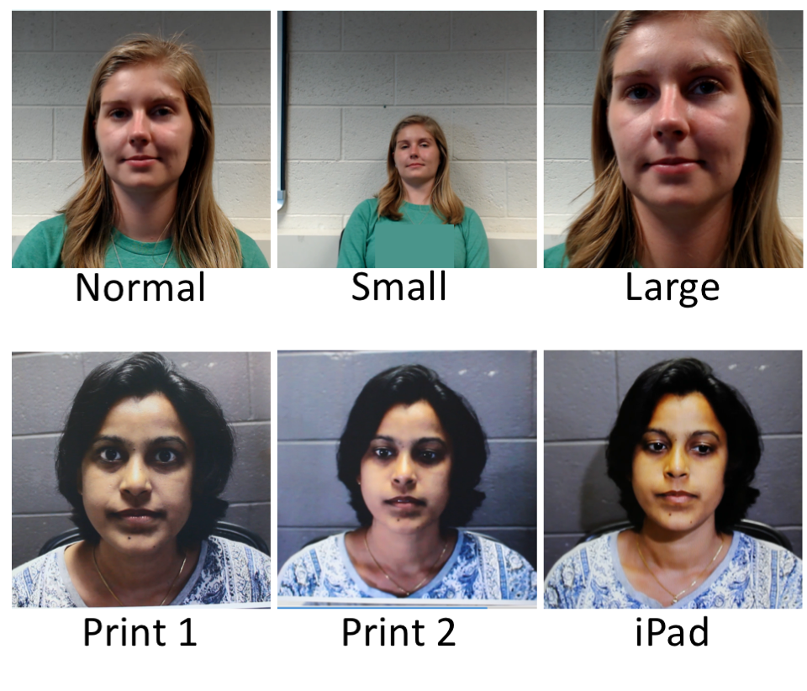
Dataset Details
Spoofing in the Wild (SiW) Database
Created and maintained by Yaojie Liu, Amin Jourabloo, and Xiaoming Liu
SiW was collected in response to the need to combat high-quality spoof mediums
SiW contains live and spoof videos from 165 subjects
Each subject has 8 live and up to 20 spoof videos
Total of 4,478 videos
Figure 8: Images from the SiW Database. Top images are genuine, bottom images are spoofed

Slide 18
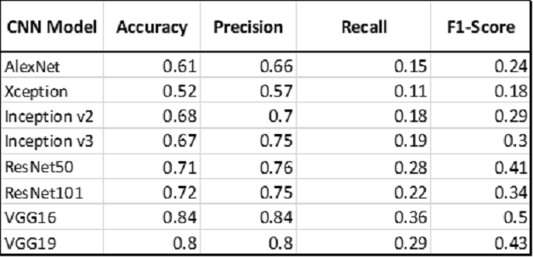
Sample Data
Table 2: CNN results from the Spoofing in the Wild (SiW) dataset

Slide 19
Tentative Timeline
Dataset Preparation/Implementation – by April 12th
90% Completed*
*Issues persist with CASIA-FASD Dataset
Problems loading data, unexpected crashes and hangs
Should have an update on these issues by Thursday (next meeting)
Implement CNNs and obtain results – final data by April 25th
80% Completed*
*CNNs will continue to be ‘tweaked’ and adjusted to enhance results
Also investigation of other novel CNNs continue
Any that are of particular interest/import may be added

Slide 20
Tentative Timeline
Unique CNN model development – by April 12th
3 current candidates:
VGG16 + ResNet50/101
VGG19 + ResNet50/101
VGG16/19 + current version of Inception (v3 or v4)
Could potentially look into ensemble model including VGG + ResNet + Inception
ResNet + Inception was promising, but recent work has been done with that combo
Plan to have decision on ~2 models finalized by Thursday (next meeting)
Journal Submission
Ongoing- Current timeframe May 15th
Rough framework is in place at the moment (abstract, intro, methodology, etc.)
Current plan: first (rough) draft by May 1st
~8 pages, 6+ figures (models, results, etc.) and 10-15 references

Slide 21
Gaps and Challenges
CNNs
Currently working to implement ‘best’ versions of each CNN
Implementation of several ‘enhanced’ versions of CNNs is planned
Investigating additional CNNs
Specifically, those tailored to be demographic bias resistant
Datasets
Ideally, need datasets that have certain demographic labels
Dealing with CASIA-FASD issues
Facial Detection/Recognition
Research of FR is starting to reach saturation point!
Need to make this research unique and novel to continue advancing the field
Accomplished via gender bias + demographic bias testing

Slide 22
Thank You Q&A

